Slide 1

Air Travel: Is it really that risky?
Andrew Jordan
Milestone 2: Executive Summary
DSC 640-T301

Slide 2

Overview
The media focus on the dangers of airline travel is a trend that must be combatted with context and facts.
Results of Data Analysis:
Fatalities by airline travel are few and far between
Automobile travel produces far more fatalities annually
Automobile travel produces far more fatalities on a per kilometer basis

Slide 3

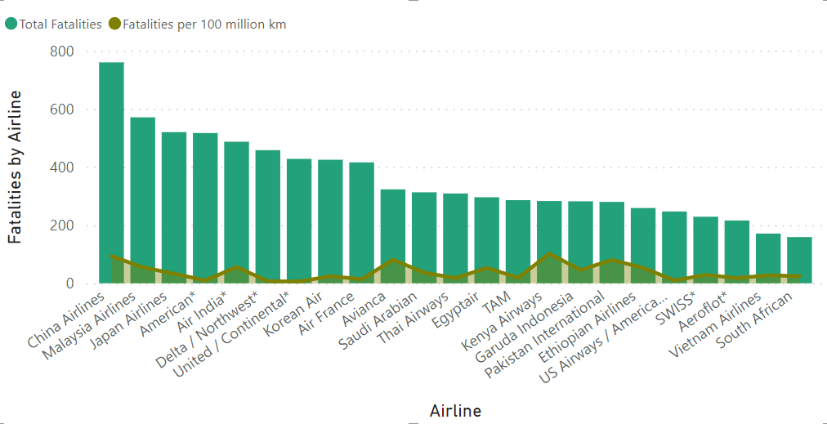

The Most “Dangerous” Airlines
The most dangerous of all airlines had less than 800 total fatalities
For every 100 million kilometers traveled the most dangerous airline had 93 fatalities

Slide 4
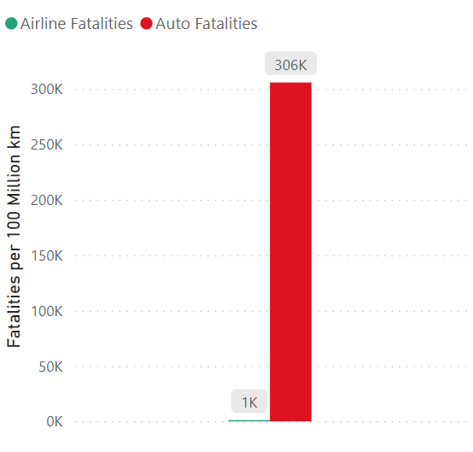
Airplane v. Automobile
For every 100 million kilometers traveled there are 306,000 fatalities involving automobiles
For every 100 million kilometers traveled there are 1,000 fatalities involving airplanes

Slide 5

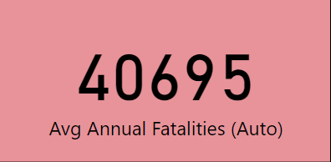

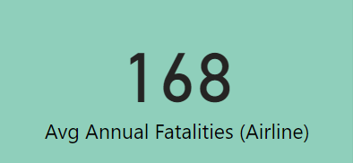
Annual Safety
For every one person who dies in an airplane related incident, two hundred forty-two people die in an automobile related incident
Automobiles, a device most use every single day, remains a far more dangerous mode of travel than airlines

Slide 6
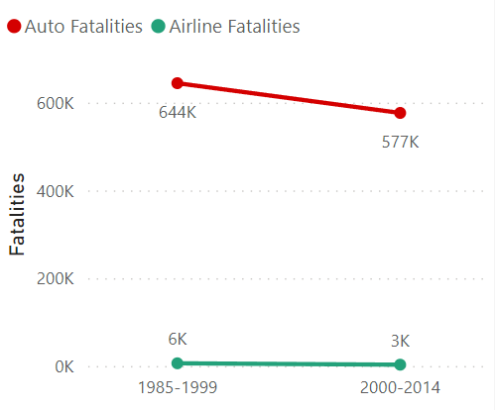
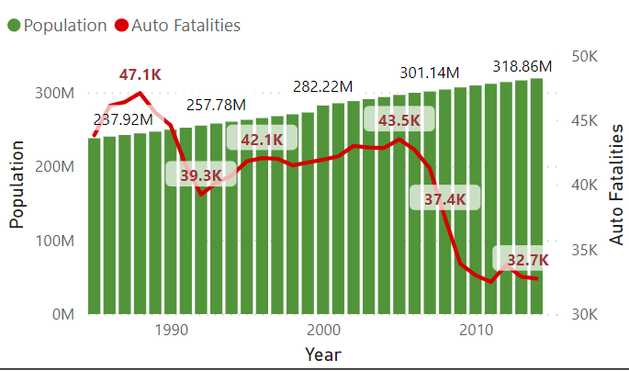
Innovations In Safety
From 1985 to 2014 airlines saw a decrease in fatalities of 50% while automobile fatalities only decreased 11%
In the United States alone, even as automobile safety has improved fatality rates, there are still over thirty-two thousand deaths every year

Slide 7
Is airline travel truly a risk?
Relative to the form of transportation most used every day, airline travel is as safe a form of travel as can be, despite what the media may convey.
The key to communicating the truth of airline safety is in presenting the relative risk. If the public can be shown what dangerous travel looks like, i.e. automobiles, then we can fully illustrate how safe an airplane really is.

